Slide 1
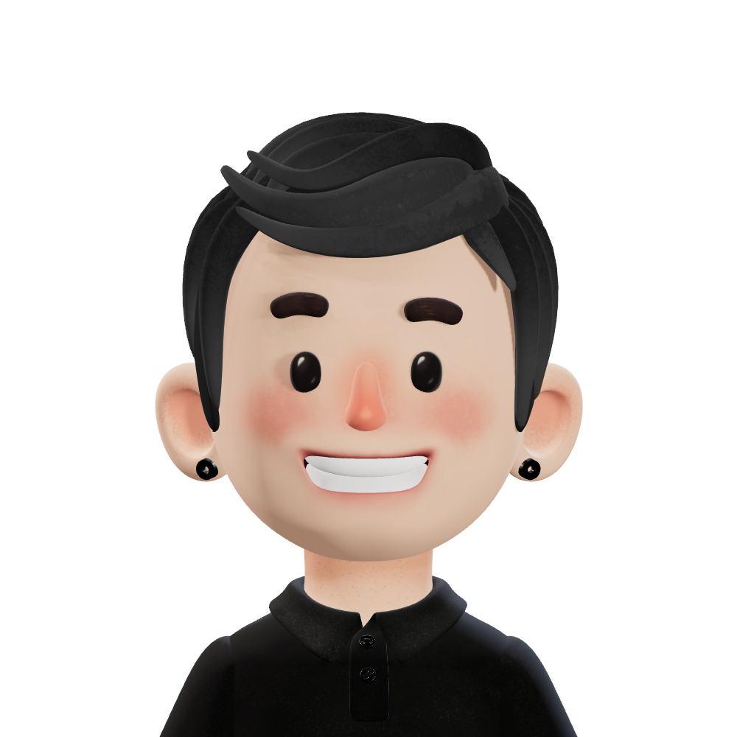
Abara One More
Mar.12.2023 Ash-Hun
Pray2U

Slide 2
Index
⬛ What should we focus on in the AI Generation?
⬛ Let’s Dive “ChatGPT”
⬛ How to use ChatGPT more efficiency?

Slide 3
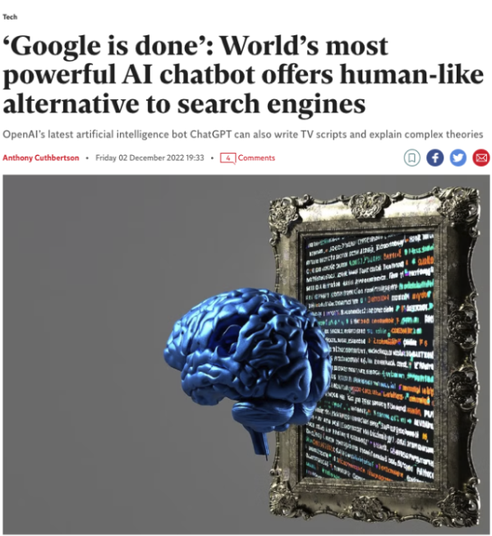
What should we focus on in the AI Generation?

Slide 4
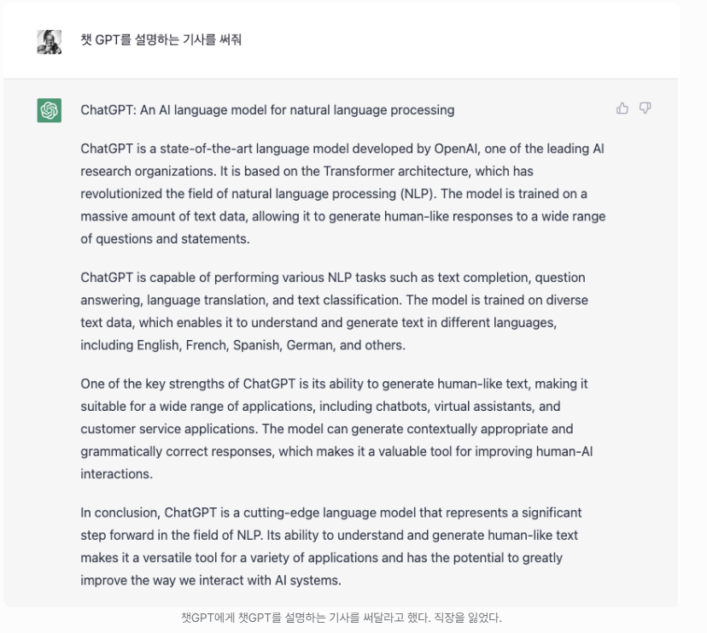
Let’s Dive “ChatGPT”
※ 2021년까지의 지식까지만 학습

Slide 5
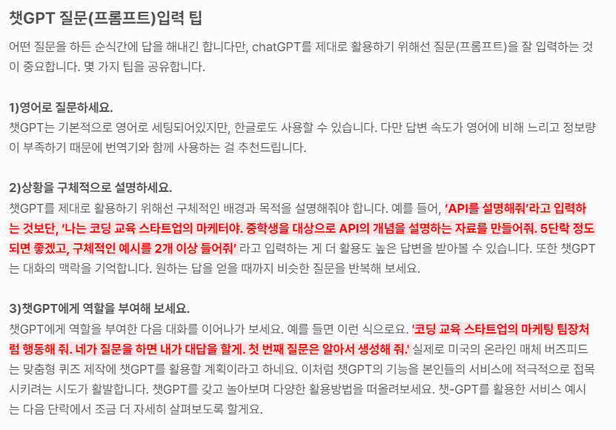
How to use “ChatGPT” more efficiency

Slide 6
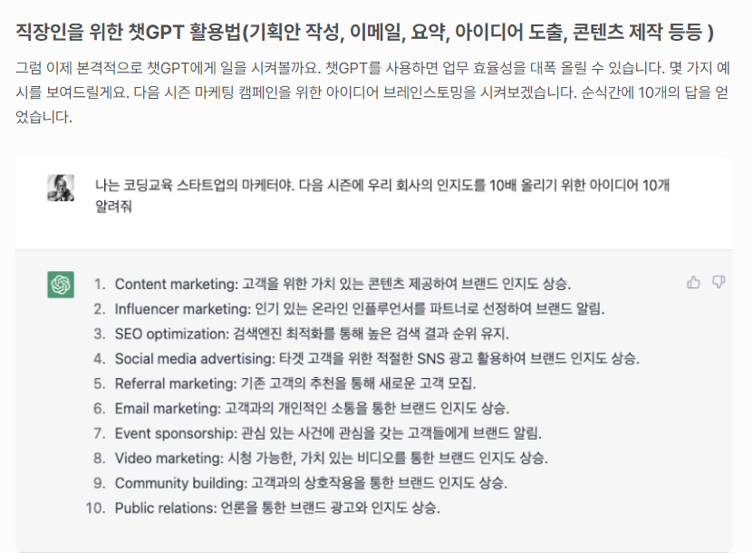
How to use “ChatGPT” more efficiency

Slide 7
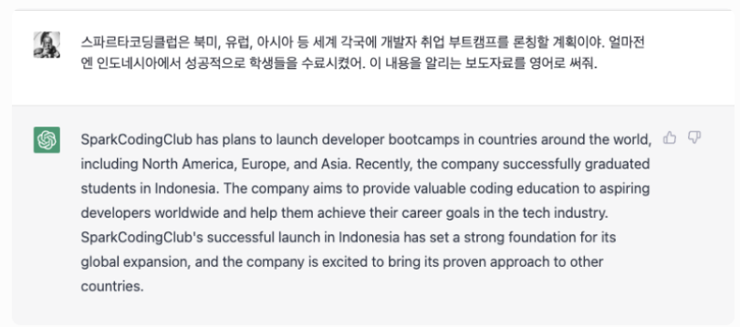
How to use “ChatGPT” more efficiency

Slide 8
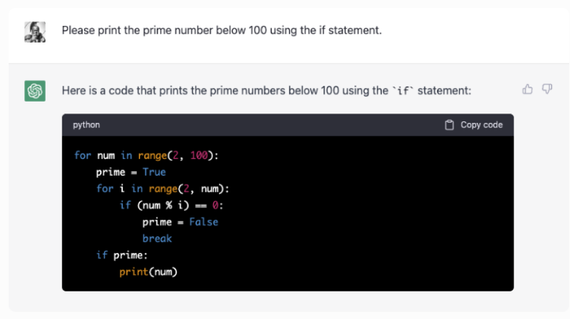
How to use “ChatGPT” more efficiency

Slide 9
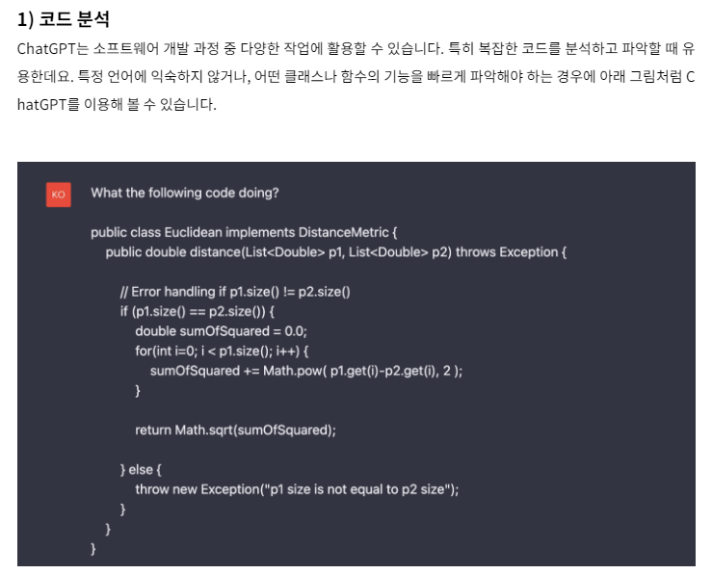
How to use “ChatGPT” more efficiency

Slide 10
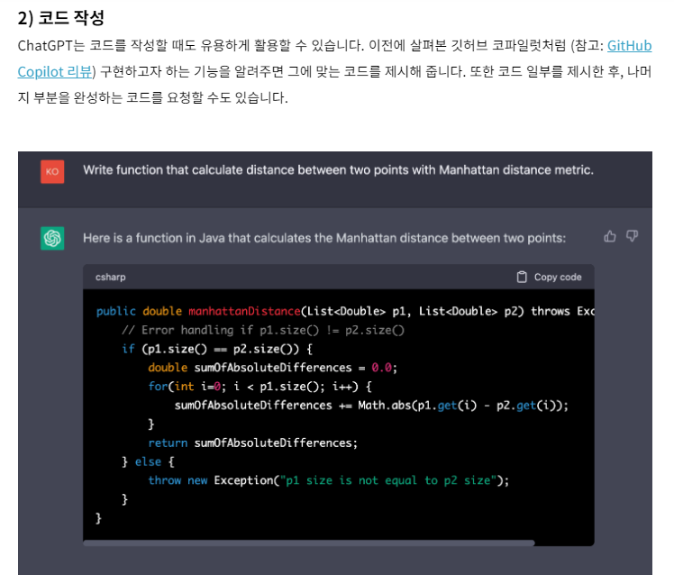
How to use “ChatGPT” more efficiency

Slide 11
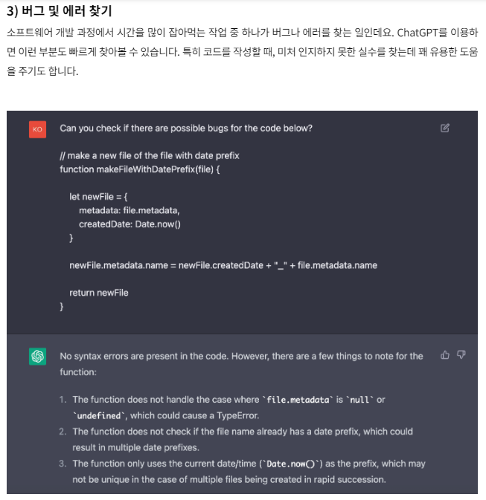
How to use “ChatGPT” more efficiency

Slide 12
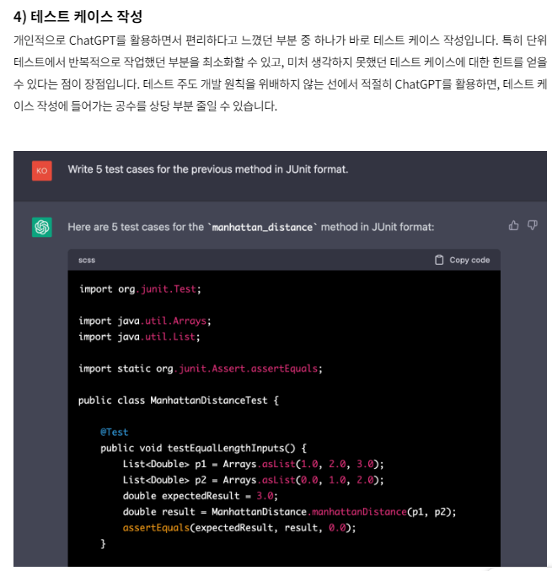
How to use “ChatGPT” more efficiency

Slide 13
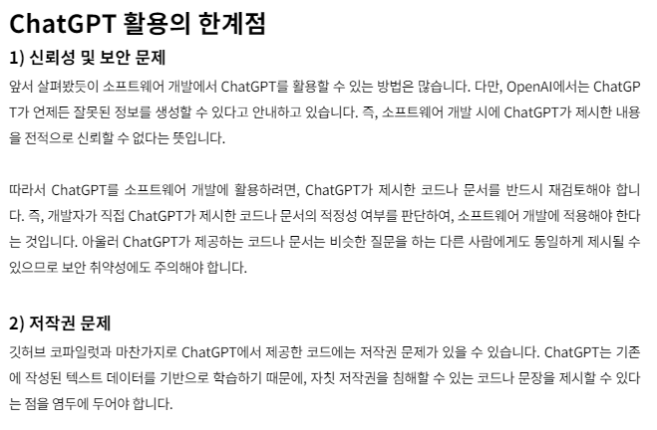
How to use “ChatGPT” more efficiency

Slide 14
Ref
[kakao enterprise Tech&] : https://tech.kakaoenterprise.com/181
[요즘IT] : https://yozm.wishket.com/magazine/detail/1901/
[ncsoft NLP Techblog] : https://ncsoft.github.io/ncnlp/022d8f7905fc7e231e56a955aee112fdc3d9b011

Slide 15
Thank you
Mar.12.2023 Ash-Hun
Pray2U

